Slide 1



Visitor Management System
Event-Driven Architecture with Scala, Akka, & Apache Kafka
SCALA AKKA KAFKA

Slide 2


Microservices Architecture
1. Visitor Management Service
(play+kafka(producer))
2. Visitor Notification Service
(akka+kafka(consumer))
The core synchronous processing unit.
The asynchronous side-effect handler.
►
Handles check-in/check-out operations.
►
Dedicated Kafka Consumer.
►
JWT-based authentication & security.
►
Decoupled from the main check-in flow.
►
Direct, non-blocking Kafka Event Publishing.
►
Handles email, SMS, and Push notifications.
►
Connects to MySQL for persistent storage.
►
Ensures system resilience if notifications fail.

Slide 3

Play Framework Deep Dive
Reactive & Type-Safe
►
Non-blocking I/O: Built on Akka to handle high concurrency with minimal threads.
// Async Controller Action
def checkin: Action[JsValue] =
secured.async(parse.json) { request =>
►
Type Safety: Scala's compiler prevents runtime errors.
service.checkin(request.body)
.map(Created(_))
►
Hot Reload: Rapid development cycles.
.recover {
case ex => BadRequest(Json.obj(...))
►
REST API: Native JSON handling makes API development seamless.
}
}

Slide 4




Akka Actors & Concurrency
High Concurrency
Fault Tolerance
Non-Blocking
Handles 1000+ concurrent visitors without blocking threads. Each request is processed asynchronously.
Actor Supervision Trees automatically detect failures and restart components, ensuring system stability.
Message-passing architecture removes locks and blocking waits, maximizing CPU utilization.

Slide 5
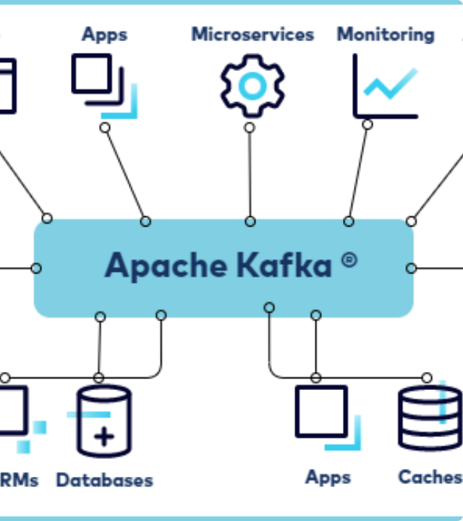
Apache Kafka Integration
A decoupled, event-driven backbone ensuring real-time data flow.
The Event Flow
►
VMS: Publishes `checkin` event directly.
►
Kafka: Buffers event reliably.
►
VNS: Consumes event & triggers notification.
Reliability
Configured with acks: all and idempotence: true to guarantee Exactly-Once Semantics.

Slide 6


Producers & Consumers
Producer Configuration
Reactive Consumer (Akka Streams)
Optimized for data integrity and throughput.
Backpressure-aware consumption logic.
// Reliability Settings
// At-Least-Once Delivery
props.put("acks", "all")
Consumer.committableSource(...)
props.put("enable.idempotence", "true")
.mapAsync(10) { msg =>
props.put("retries", "3")
process(msg.value)
}
// Async Publishing
.via(Committer.flow)
producer.send(record)
.runWith(Sink.ignore)

Slide 7
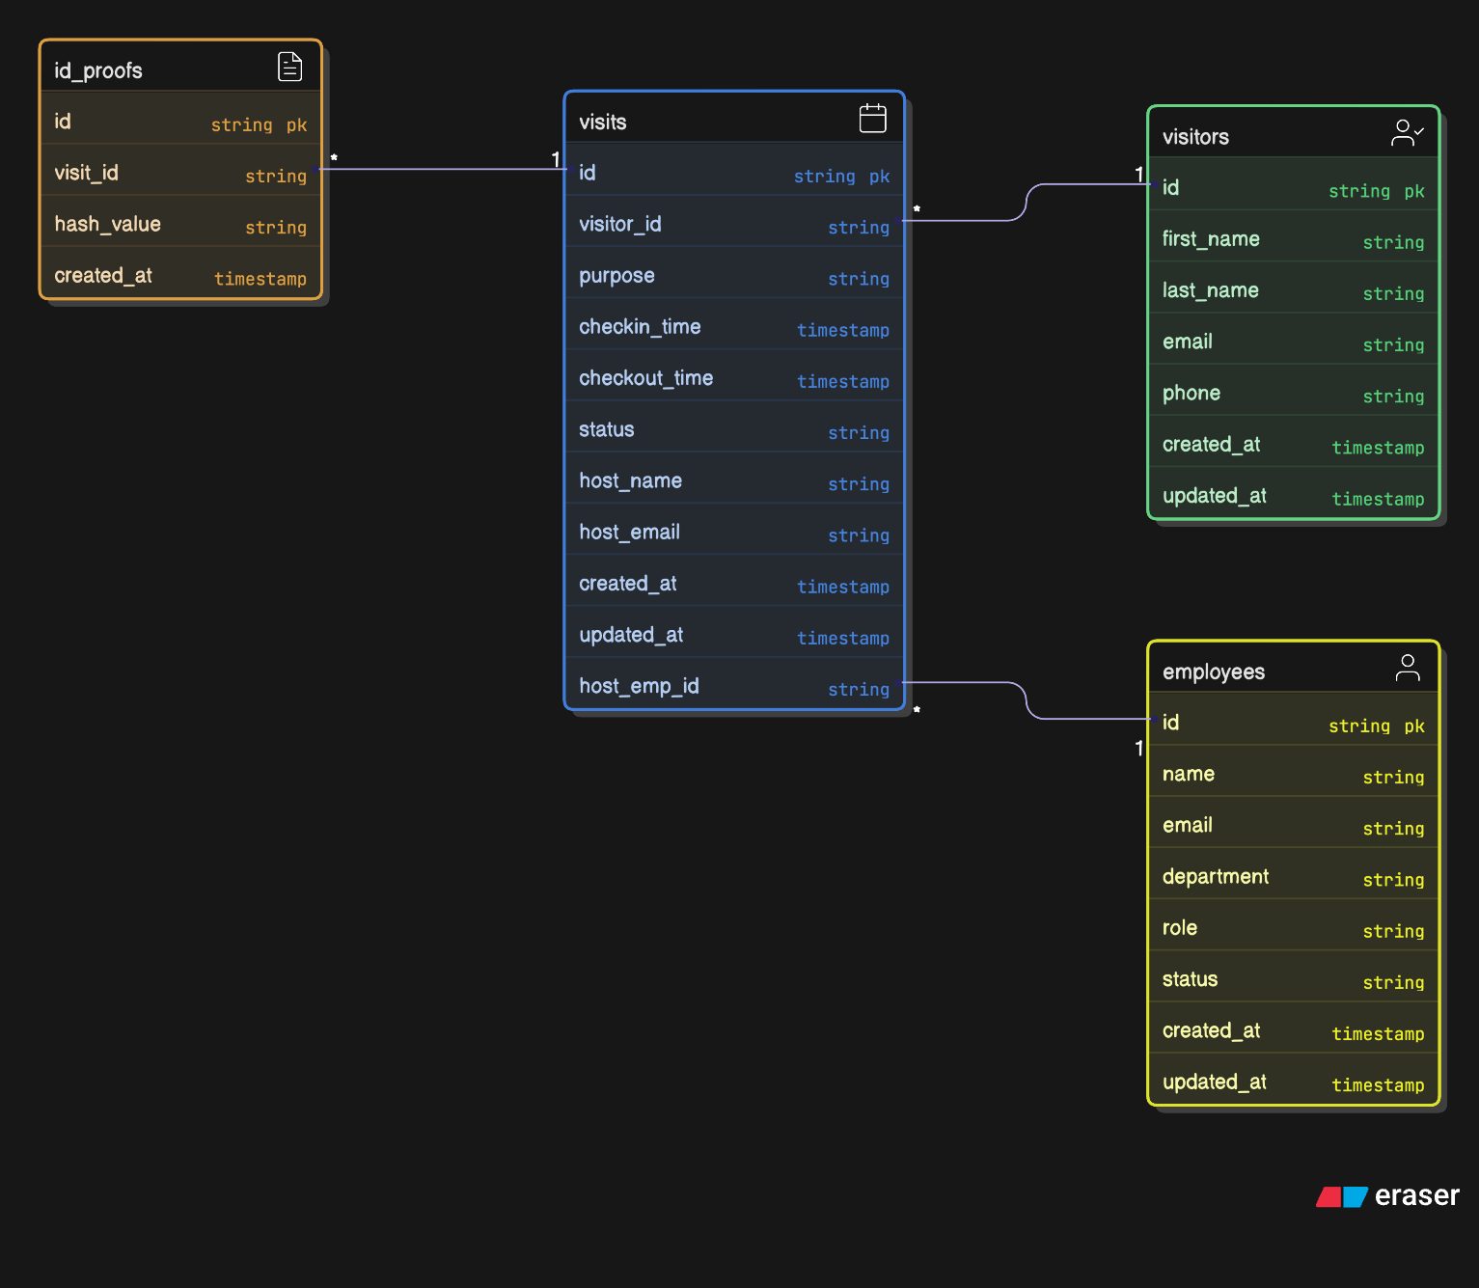
Database & Architecture

Slide 8
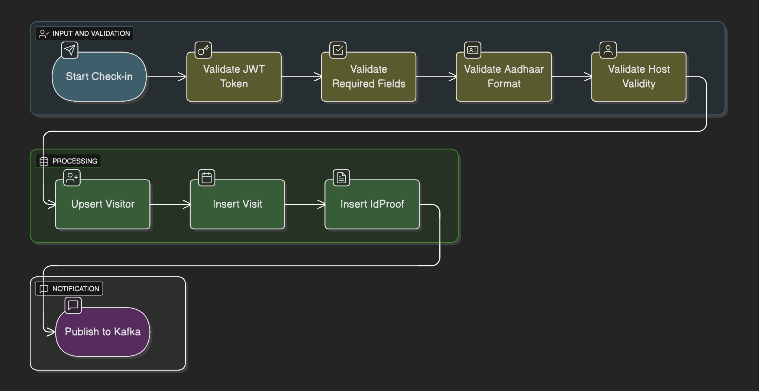
Visitor Check-in Flow

Slide 9
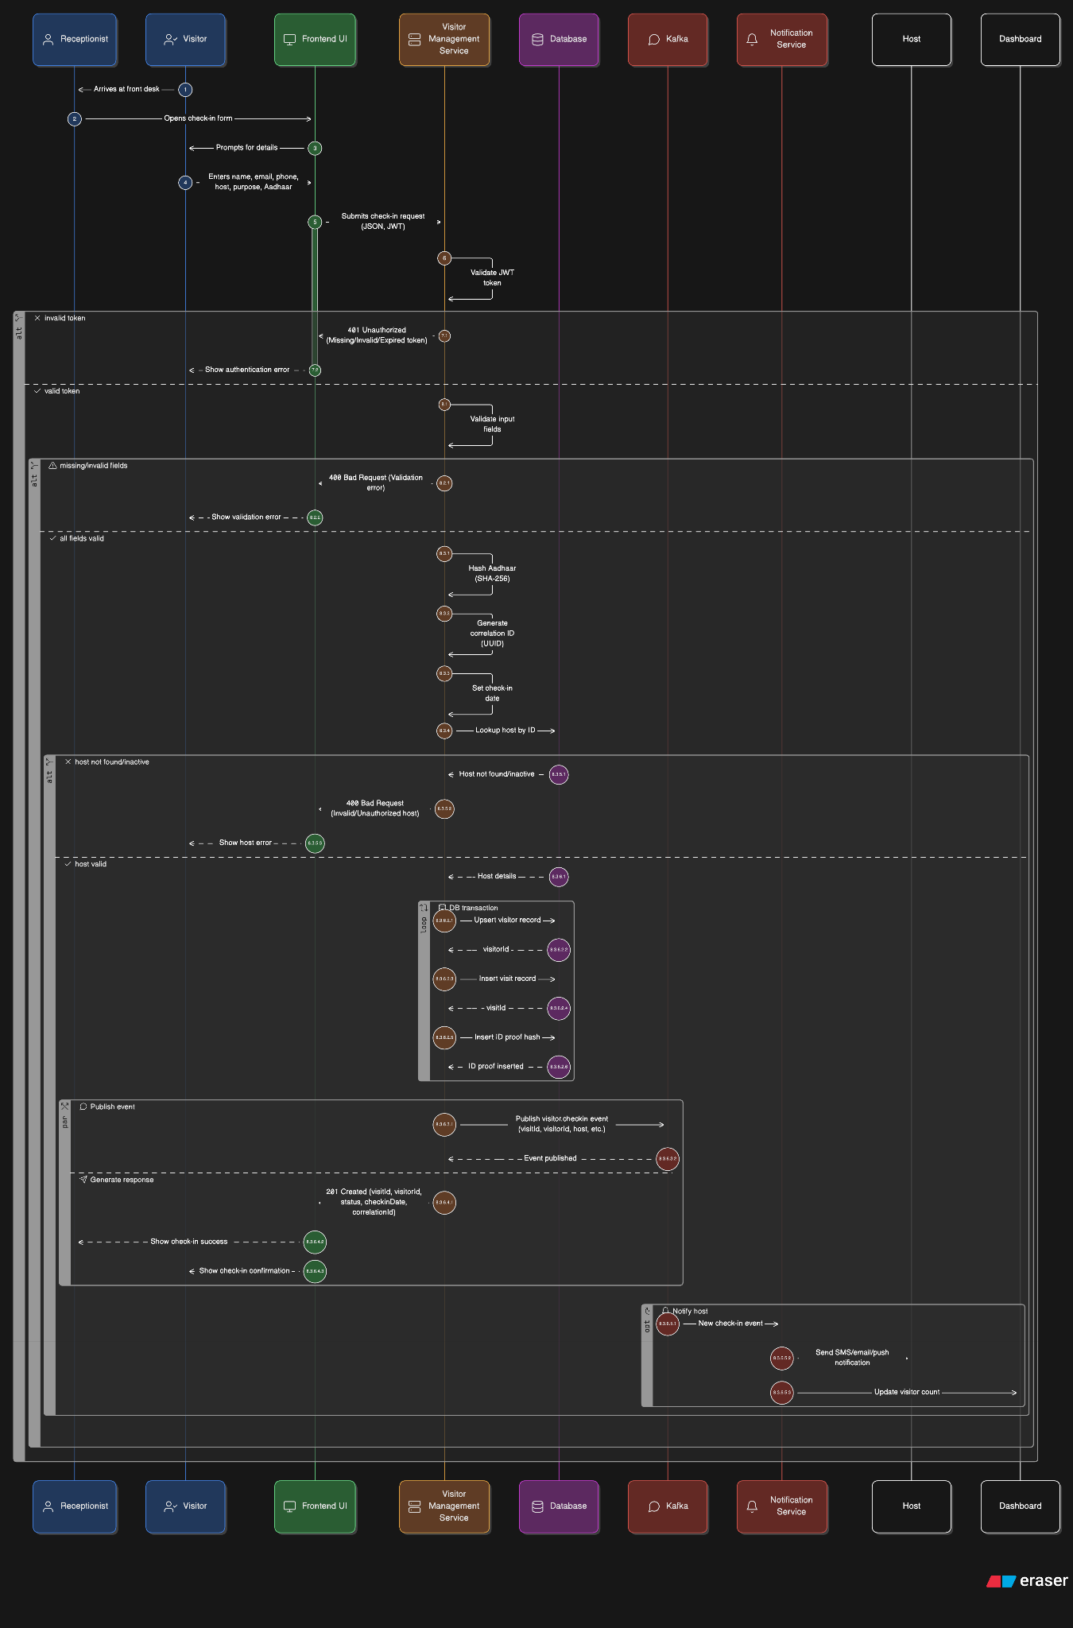
Visitor Arrives
Reception Opens UI
JWT Auth Validated
Controller Validates Input
Service Applies Logic
DB Transaction Insert
Kafka Event Published
Success Response Sent
Consumers Trigger Actions

Slide 10

Security & Next Steps
Security Pillars
►
JWT Authentication: Stateless, secure API access.
►
Privacy: SHA-256 Hashing for visitor IDs.
►
Resilience: Circuit Breakers for external APIs & Dead Letter Queues for Kafka.
Roadmap
►
GraphQL API for flexible queries.
►
CQRS for read/write optimization.
►
QR code for check-in

